Slide 1
STICAT
Project Report
By：Rose Aria Audrey Maggie

Slide 2
01
Project Overview
Plan & Progress
02
contents
03
Achievements Display
Challenges & Solutions
04

Slide 3
01
Project Overview

Slide 4

L
About STICAT
STICAT is a Computer Aided Tool developed by Rose and some other students in teacher Han's class when we learn database principles.
URL: http://sti.blcu.edu.cn/sticat
STICAT Logo

Slide 5
Techniques in STICAT
This tool mainly uses HTML, CSS, JavaScript, Ajax, Bootstrap, PHP.
In order to realize reading files function and align function at the same time, we use API to import the files.
In order to get Machine Translation as reference, we use Baidu Translation API.
In order to get matched Translation Memory, we calculate the Levenstein edit distance and take sentences that match up to 60%.
As for the whole management system, we also designed many tables and charts.
All in all, this website concludes many pages. So it is quite suitable for our localization practice.

Slide 6
02
Plan
&
Progress

Slide 7
Analysis of the project
Time
Because some fatal mistakes occurred in our previous project BBS. So we have to change our project to STICAT. When we decided to localize, there was only about 4 weeks left.
Personal preference
Maggie and Aria want to try technical works. Audrey would like to do translation job. Rose are prefer to be a Project Manager..
Workload
After preliminary analysis, the site has 86 pages that need to be localized.
Please see Annex 1 for details

Slide 8
Division of labor Please see Annex 2 for details
Rose – Project Manager
Analysis Project, make division and planning, monitor the project, make online tests, make midterm and final report
Maggie – Localization Engineer
Mainly responsible for extracting the texts, Replace the texts into variables.
Aria – Localization Engineer Make switch function, replace the texts into variables, make language packages..
Audrey – Translation
Help Maggie Extract the texts, Translation, quality assurance and online tests.

Slide 9
Plan
STICAT
Analysis & Preparation
Translation & QA
Testing & Report
Technical

Slide 10
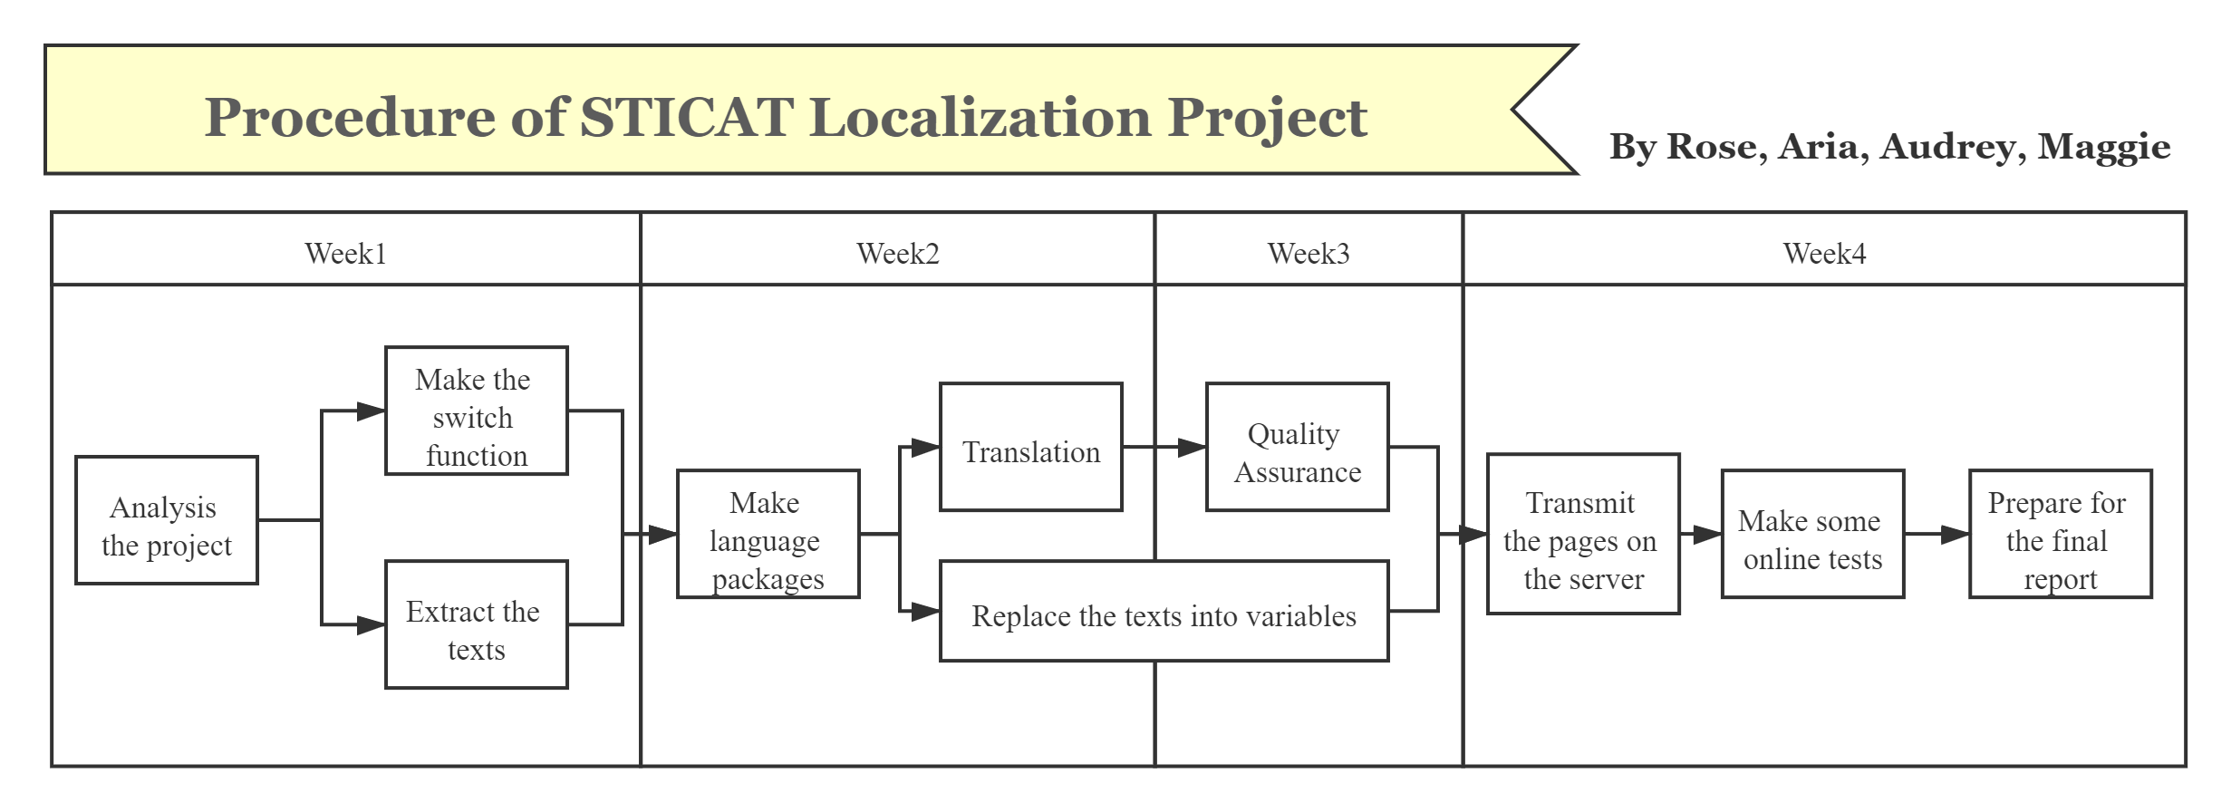
Procedure

Slide 11
Schedule
100%
70%
50%
30%
Analysis & Preparation
Technical
We have done all the technical part except language packages.
Translation & QA
We have finished translation part.
Testing & Report
We only finished midterm report.

Slide 12
03
Achievements Display
Notes:
PPT模板： www.1ppt.com/moban/ 行业PPT模板：www.1ppt.com/hangye/
节日PPT模板：www.1ppt.com/jieri/ PPT素材： www.1ppt.com/sucai/
PPT背景图片：www.1ppt.com/beijing/ PPT图表： www.1ppt.com/tubiao/
优秀PPT下载：www.1ppt.com/xiazai/ PPT教程： www.1ppt.com/powerpoint/
Word教程： www.1ppt.com/word/ Excel教程： www.1ppt.com/excel/
个人简历： www.1ppt.com/jianli/ PPT课件： www.1ppt.com/kejian/
手抄报： www.1ppt.com/shouchaobao/ 试题下载： www.1ppt.com/shiti/
教案下载： www.1ppt.com/jiaoan/ 字体下载： www.1ppt.com/ziti/

Slide 13
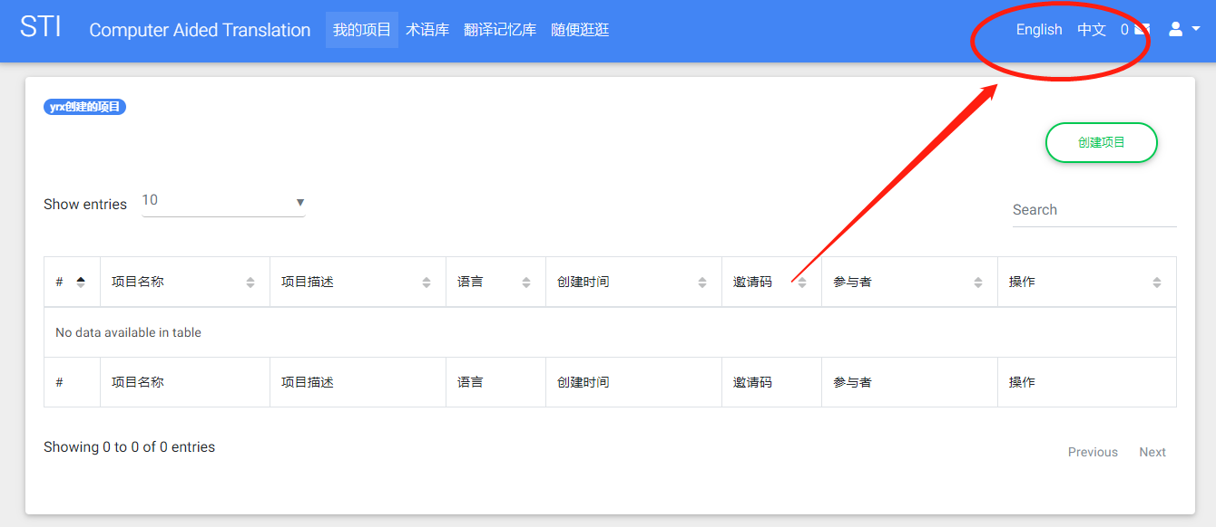
Switch function

Slide 14
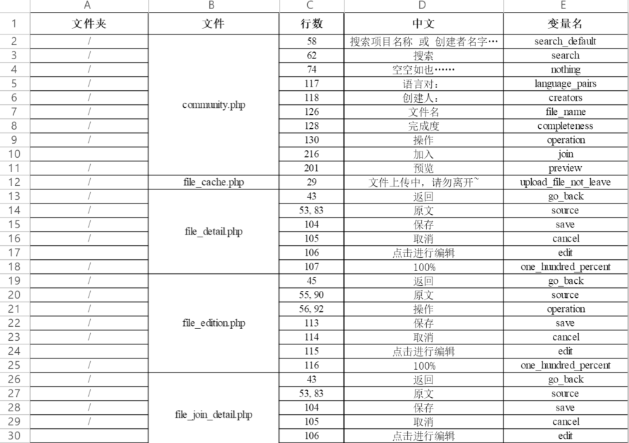
Extracted Texts
We use variables to replace texts.
In order to ensure the consistency of the variable names of the text with the same content, we first extracted the text that needs to be replaced in each file, and gave the text with the same content to the unified variable name.
Here is the text extracted from each file that needs to be replaced.
Please see Annex 3 for details

Slide 15
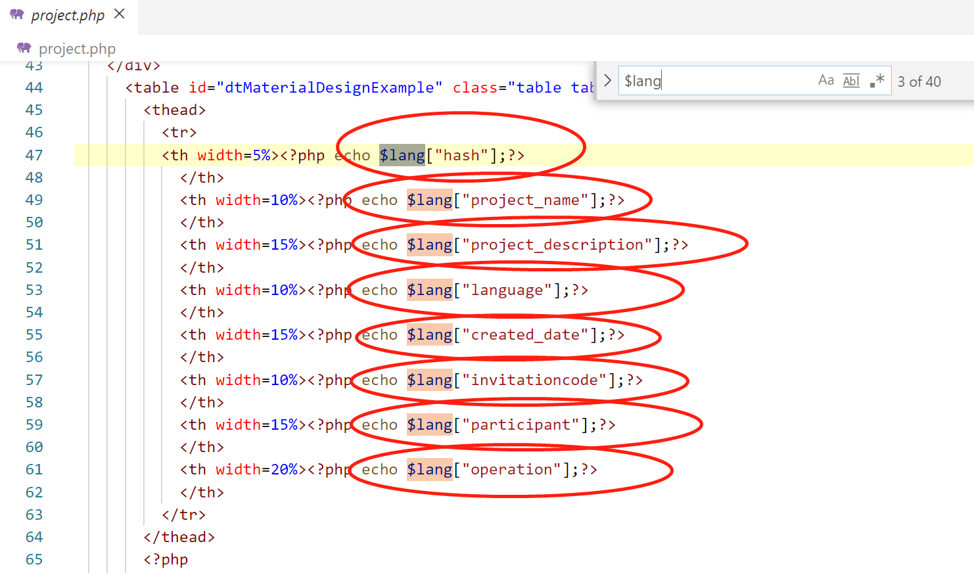
Replaced texts in pages
We have completed the replacement of text in 86 pages.
The replacement methods are as shown in the left picture
Echo $lang[“variable name”];

Slide 16
04
Challenges
&
Solutions

Slide 17
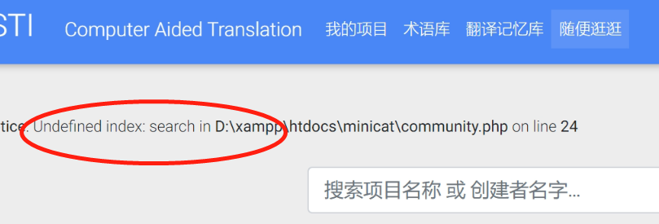
Challenge 1
Aria encountered many problems when making the switch function:
1. Because of the problem of passing parameters, the parameters may be in the URL. If you use the get method to change the page’s language directly, the parameters will be lost.
2. JavaScript cannot be used because JavaScript cannot set session.

Slide 18
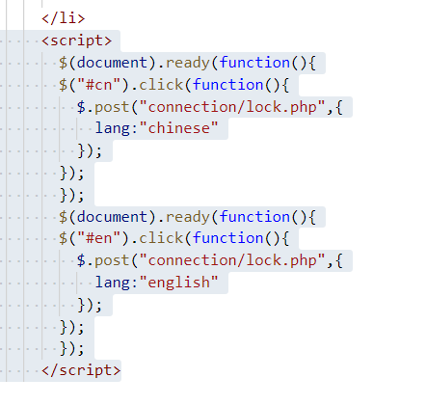
Solution 1
Aria uses Ajax technology to set the language. The code is shown on the right.

Slide 19
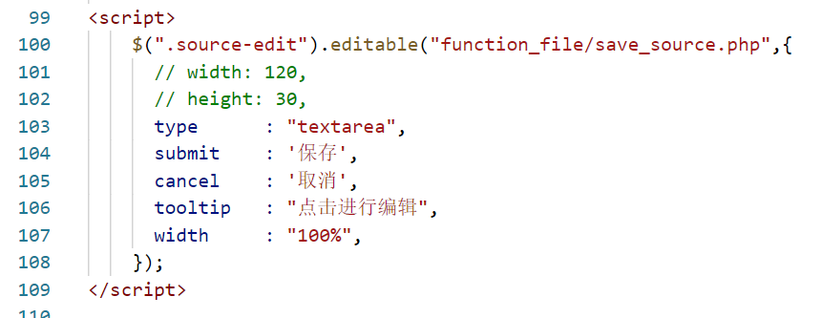
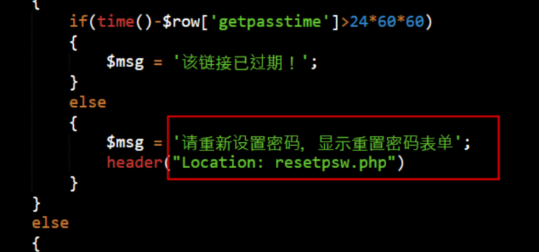
Challenge 2
We also encountered a problem when extracting the content of the page.
Because the person who extracted the content of the page (Maggie $ Audrey) are not the developer, they usually confused about some texts’ corresponding pages, such as shown on the right.
This may cause some places to be missed, and some places that do not need to be extracted.

Slide 20
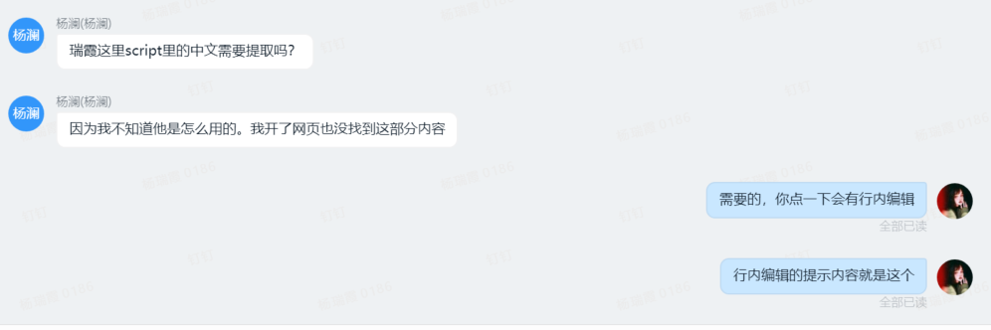
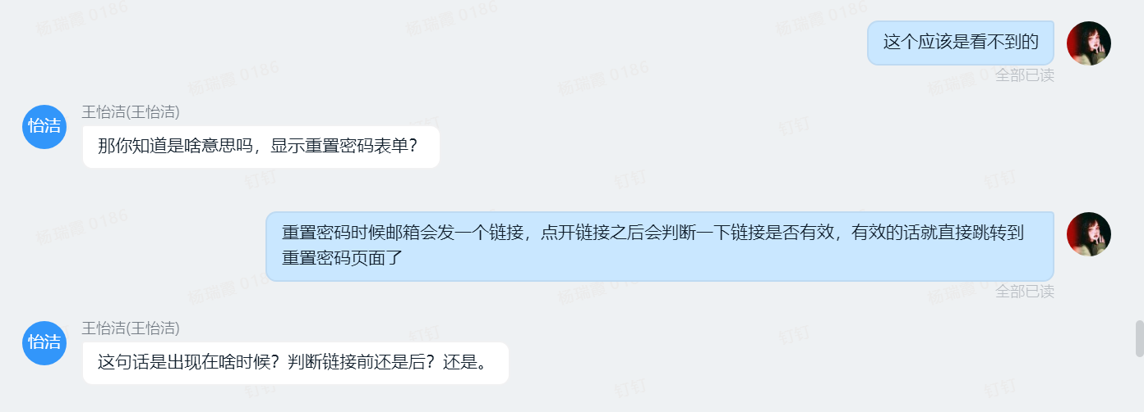
Solution 2
1.View the corresponding original page.
2.Communicate with the developer (Rose) in time, and ask the developer (Rose) at any time if you don’t understand
At the same time, compared to WeChat, we have adopted DingTalk. It is more efficient. As shown on the right are some of our communication records.

Slide 21
STICAT
THANKS

